Slide 1
The Congress of Vienna
1814-1815
One of the most important international
conferences in European history

Slide 2
The Congress of Vienna Five “Great Powers” in Attendance
Austria- Emperor Francis I
Prince Klemens von Metternich
Great Britain-foreign ministers
Viscount Castlereagh, duke of Wellington,
Prussia- King Fredrick William III
Russia- Czar Alexander I
France- foreign ministers
Louis XVIII of France sent Charles-Maurice de Talleyrand.

Slide 3
Important questions to answer…
How should France be dealt with?
How to piece together the ruins of Napoleon’s empire? How should the countries conquered by Napoleon be restored?
How could peace and stability in Europe best be preserved?
What territorial adjustments had to be made?

Slide 4
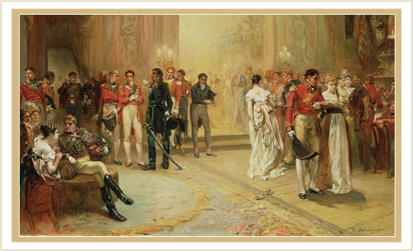
The Congress of Vienna
September 1814 - June 9, 1815
Intended to last 4 weeks
Went on for 8 months
Most glamorous gathering Europe had ever seen

Slide 5
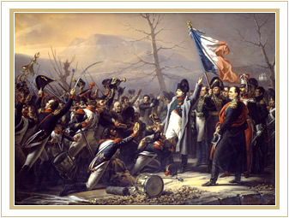
Six months into the Congress of Vienna, word arrived that Napoleon had escaped exile on Elba and no one knew for certain where he was headed. A shocked Congress declared Napoleon an outlaw.

Slide 6
With Napoleon Bonaparte presumably defeated and exiled to the small island of Elba, heads of some 200 states gathered in Vienna to begin piecing together the ruins of his toppled empire.
The unprecedented gathering soon degenerated into a glittering Vanity Fair - a seemingly endless stream of personal vendettas, long-simmering feuds, and romantic entanglements.
In the end, the hard-fought policy decisions would shape the destiny of Europe and lead to the longest sustained peace the continent would ever see.

Slide 7
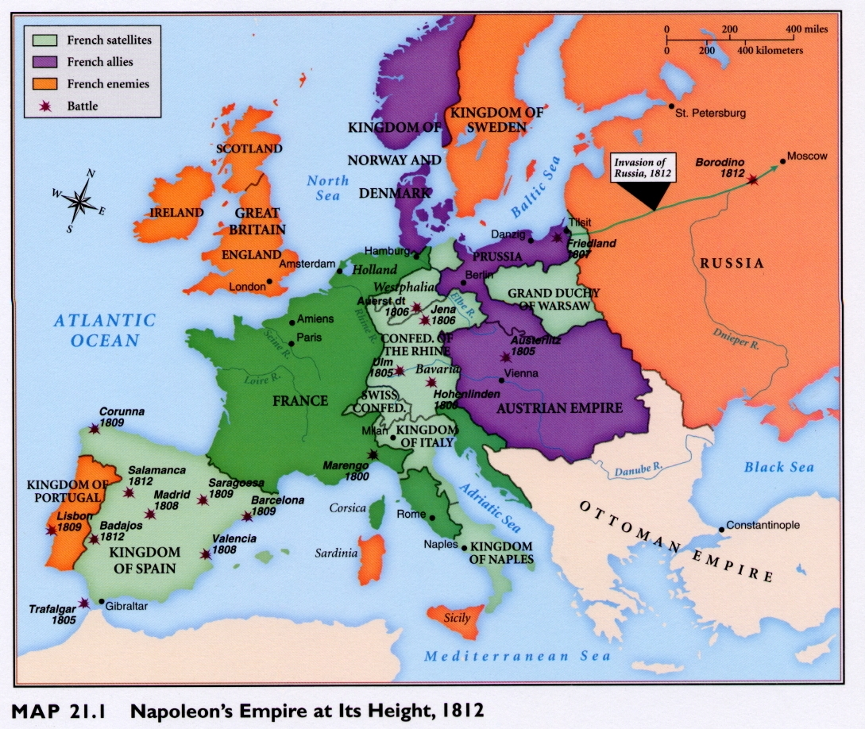

Slide 8
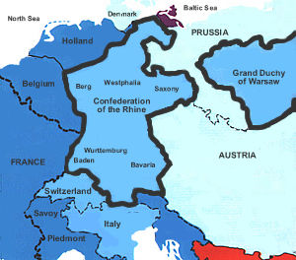
The Confederation of the Rhine
German states who allied with
Napoleon after his defeat of the
Austrians at Austerlitz (1806).
All German states except Austria
and Prussia joined.
Confederation provided buffer
against enemies on France's east-ern borders. Also contributed troops to Napoleon’s armies.
After Napoleon's retreat from
Russia (1813) many members changed sides in the war and the Confederation collapsed.

Slide 9
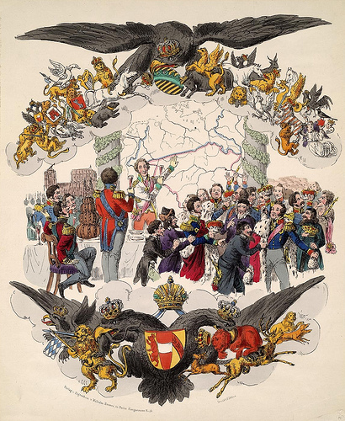
The Congress of Vienna General Goals of the Participants
Establish long-term peace
and stability in Europe after
Napoleonic wars.
Establish a balance of power to
ensure no nation could dominate
the continent.
Provide collective security for
the whole continent.

Slide 10
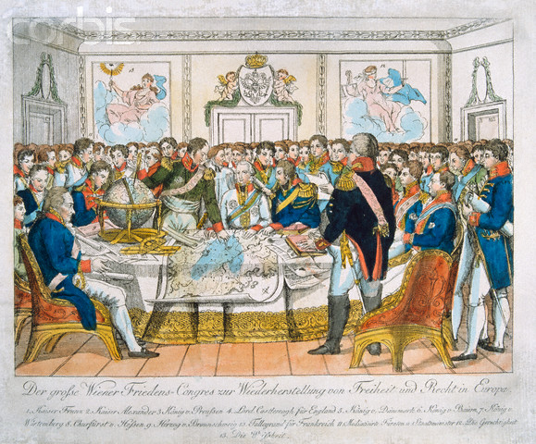

Slide 11
The “Age of Metternich”
Klemens von Metternich
Austria’s foreign minister for 39 years.
Most influential person at Vienna.
Conservative aristocrat who opposed democratic ideals of the French Revolution.

Slide 12
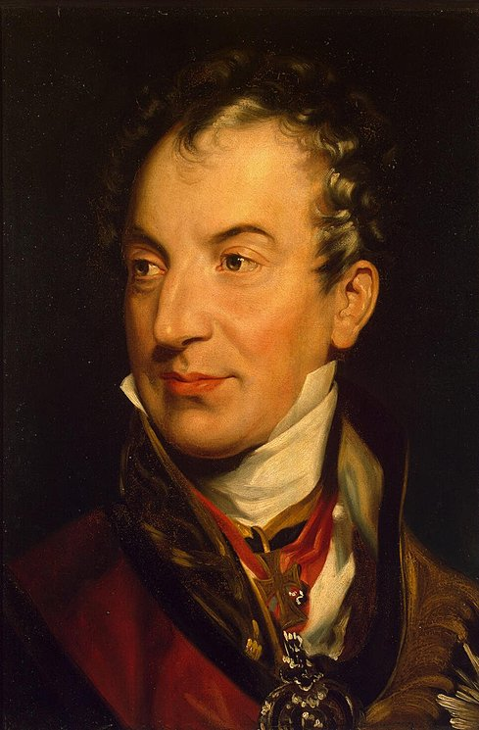
Great Powers at Vienna Metternich’s Goals:
Create balance of power to
maintain stability.
Prevent future aggression by France by strengthening surrounding states.
Make Austria the dominant German state by limiting the expansion and influence of
Prussia and Russia.
Restore monarchies to power.
.
Clemens von Metternich
Austrian Foreign Minister

Slide 13
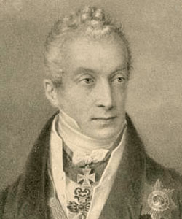
Great Powers at Vienna Metternich’s Goals:
Did not want to humiliate or
punish France. Why not?
Didn’t want to plant the seeds
of revenge that might lead to
future wars.
“ A bitter France is a dangerous France.”
Also feared that a weakened France would disrupt balance of power in Europe.
Clemens von Metternich
Austrian Foreign Minister

Slide 14
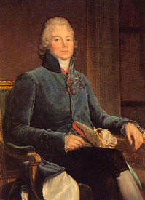
Great Powers at Vienna France’s Goals:
Keep France strong.
Gain legitimacy and be
treated as major power.
Minimize its losses.
Return to its “natural”
(prewar) borders.
Keep Poland independent (keep Russia and Prussia from taking it).
Charles de Talleyrand
France

Slide 15
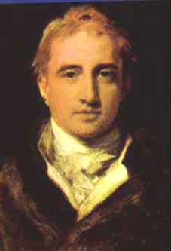
Great Powers at Vienna Great Britain’s Goals:
Maintain balance of power
to ensure stability.
Make sure no country emerges
too powerful.
No territorial claims Europe.
Some territorial compensation
(island colonies)from France.
Push back France’s borders.
Prevent Russia from acquiring
Poland.
Lord Castlereagh
Great Britain

Slide 16
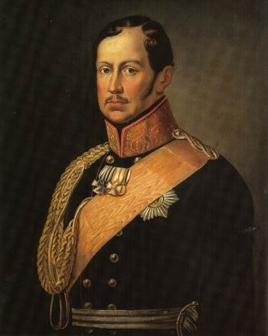
Great Powers at Vienna Prussia’s Goals:
Feels that Prussia played key
role in defeating Napoleon and now should be rewarded with territory.
Wants the German state of Saxony.
Wants to maintain its alliance with Russia.
Frederick Wilhelm III
Prussia

Slide 17
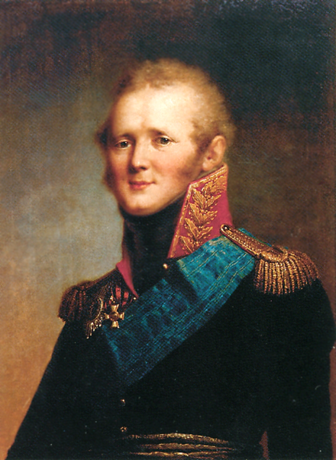
Great Powers at Vienna Russia’s Goals:
Wants Russia accepted as a
great European power.
Wants Finland and Poland
added to Russia as reward for
fighting Napoleon.
Wants “Holy Alliance” based
on Christian principles w/
Prussia and Austria
Czar Alexander I
Russia

Slide 18
Alliances of Convenience at Vienna
Russia and Prussia
VS
France, Britain, and Austria
Made agreement to support each
other’s territorial demands. Russia
agreed to support Prussia’s bid for
Saxony, while Prussia agreed to
support Russia’s bid for Poland.
Signed secret treaty to oppose the
Russians and Prussians and keep
them from gaining all of Poland
and Saxony.

Slide 19
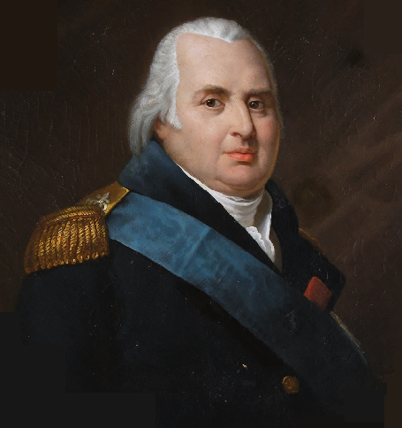
How France was Dealt With
Was forced to give up all its
conquered territories
Was NOT harshly punished.
Kept intact with independent
army and government.
Monarchy restored to power.
Weak neighboring states were
strengthened.
King Louis XVIII
(Brother of Louis XVI)

Slide 20
The Containment of France
To keep France contained, several new states / politcal entitities were created along France’s borders, making them stronger:
Kingdom of the Netherlands established by joining together the former Austrian Netherlands and Dutch Republic.
German Confederation created by joining together 39 German states.
Switzerland was made an independent state.
Kingdom of Sardinia in Italy was strengthened by the addition of Genoa.

Slide 21
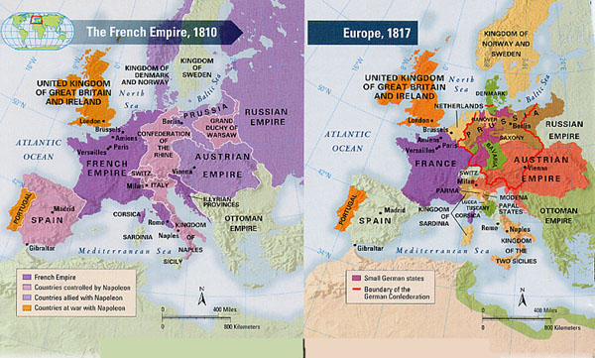
How Did the Map of Europe Change?

Slide 22
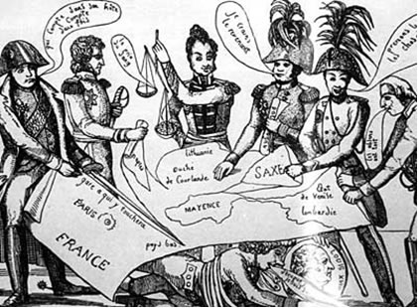
New Map of Europe, 1815
France reduced to its pre-
war (1789) borders.
Prussia, Austria, Russia all
gained territory.
Prussia awarded part of
Saxony
Poland divided between,
Russia, Prussia, and
Austria with largest share
going to Russia.
Russia also gained Finland.
Britain got islands in North
Sea and Mediterranean from
France.
Interactive Map of Europe 1915

Slide 23
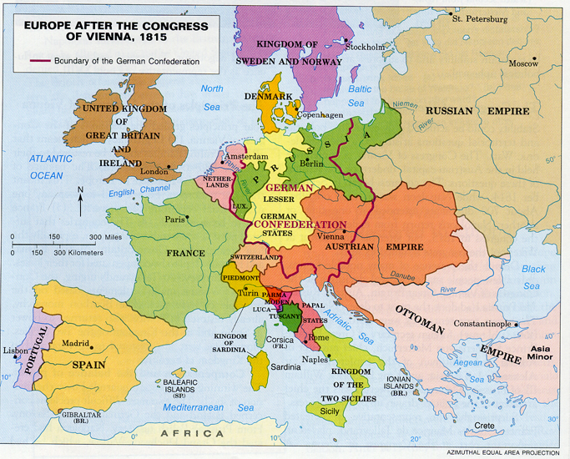

Slide 24
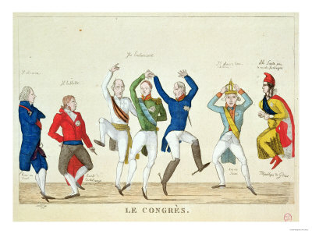
Congress of Vienna Mostly a Success!
No major power left angry over results
-- so did not sow the seeds of future wars.
No country emerged with too much power.
Conflicting interests were resolved through
peaceful negotiations
Triumph of diplomacy!

Slide 25
A Victory for Conservatives
Victory for conservatives trying to undo the
French Revolution
Monarchies restored to power in country after country (Principle of legitimacy)
Absolute monarchs Russia, Prussia, and Austria.
France joined Britain as a constitutional monarchy.
A series of alliances, the Concert of Europe
, bound nations to help one another if threatened by future revolutions.

Slide 26
Legacy of the Congress of Vienna
France weakened, but remained a major European power.
Power of Britain and Prussia increased.
New balance of power brought peace to
Europe between major powers for nearly forty years – longest period of peace in Europe’s history.
National aspirations of some peoples in Europe
were disregarded. Growing nationalism led
to new revolutions and the creation of new states (Italy, Germany, Greece)

Slide 27
Ideals of the French Revolution Lived On!
French experiment in democracy
had failed but new political ideas
were set in motion that could not
be stopped.
Ideas on democracy, liberty, equality,
and the rights of man slowly took hold
through-out Europe and other parts
of the world.
These ideas would inspire other
revolutions. Latin Americawould be
next…

Slide 28
